Slide 1
Artificial Intelligence: The Risk is not artificial!
Janell Forget, RN, BSN, JD, CPHRM, FASHRM
Joanne Hoban, Esq

Slide 2
Objectives
Recognize and define the types of artificial intelligence used in healthcare organizations and the importance of understanding their function.
Develop risk mitigation techniques that promote patient safety in artificial intelligence.
Describe areas of vulnerability as they relate to data exchange, discoverability and peer protection and how the regulatory landscape is evolving making this even more complex.

Slide 3
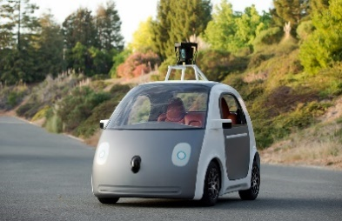
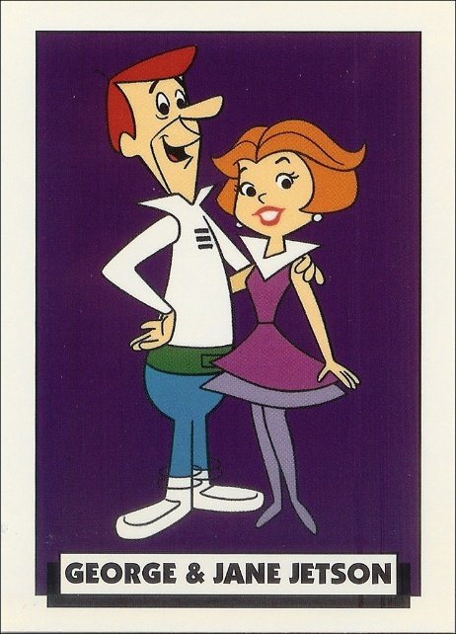
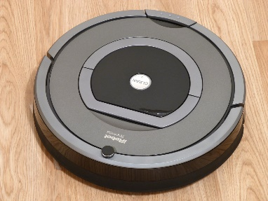
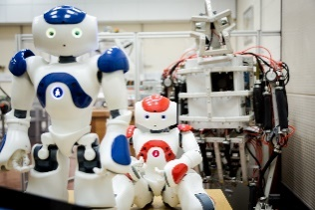

Seems like only yesterday . .
But it was ALREADY 50 years ago!

Slide 4
But AI was already in play!
Artificial Intelligence (AI) was initially introduced to the world of health care in 1956 at a conference at Dartmouth.
The initial proposal by John McCarthy, a mathematics professor at the college was
“to proceed on the basis of the conjecture that every aspect of learning or any other feature of intelligence can in principle be so precisely described that a machine can be made to simulate it.”

Slide 5
What are we talking about?
Let’s take a quick trip through time.
It’s no surprise that advances in medicine also have an affect on advances in AI.
Although the concept was introduced in 1956, we have no evidence of successful projects or the introduction of AI until the 1970’s with rule-based approaches and clinical decision support systems.

Slide 6
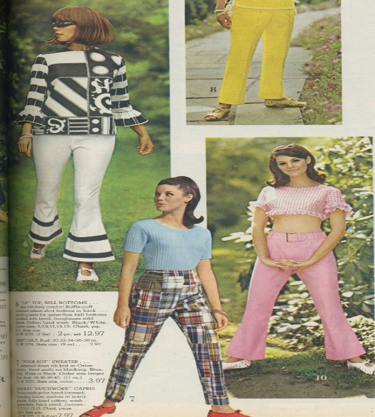

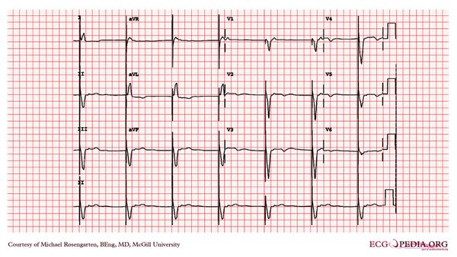
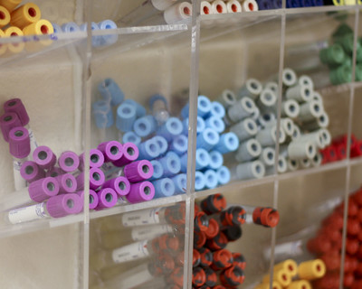
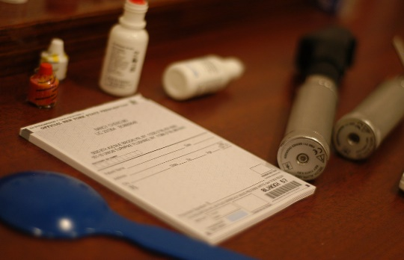
20 years of “learning” 1970-1990

Slide 7
But the technology needed to “grow”
Original/1st generation AI
Rule based
Need robust decision rules
Require human-authored updates
Still require a large amount of human interaction
Machine learning methods
Account for complex interactions to identify patterns from the data
Supervised or unsupervised
Collect large numbers of cases or data
Train “neural” networks on datasets to “solve” problems or identify issues through series of algorithms.

Slide 8
Success!
The increase in the use of AI has been driven by successful use of:
Application of deep learning
Increased neural networks
Increased understanding and development of algorithms
Increased use of algorithms
What does this all mean???

Slide 9

It’s coming soon to a facility near you!

Slide 10
What are the common sources?
Basic Biomedical Research
Automated Experiments
Automated Data Collection
Gene Function Annotation
Prediction of Transcription Factor Binding Sites
Simulation of Molecular Dynamics
Literature Mining
Translational Research
Biomarker Discovery
Drug-Target prioritization
Drug Discovery
Drug Repurposing
Prediction of Chemical Toxicity
Genetic Variant Annotation
Clinical Practice
Disease Diagnosis
Interpretation of Patient Genomes
Treatment Selection
Patient monitoring
Patient Risk Stratification for Primary Prevention

Slide 11
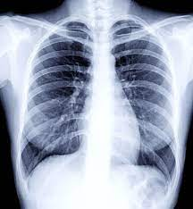
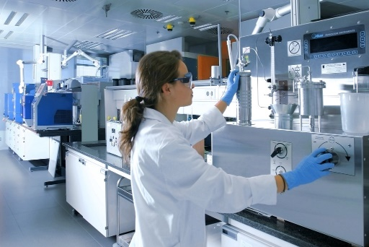
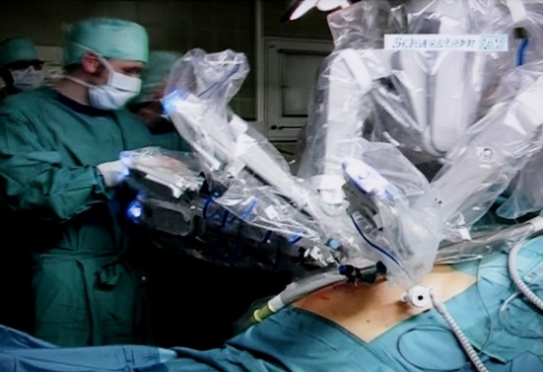

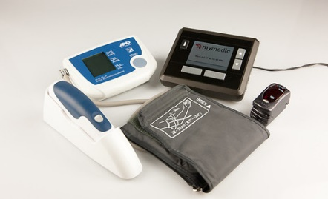
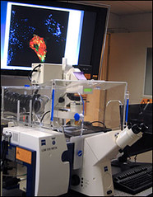
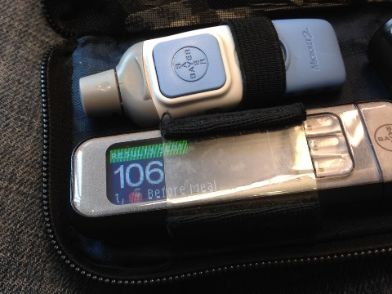
What are we doing?

Slide 12
Develop Governance
UMass Memorial Health Artificial Intelligence / Data Mining Workgroup Charter
Background Artificial intelligence (AI), machine learning (ML) and data mining (DM) in our record represent important new tools for the practice of medicine. They enable new capability but create new risks as well.
Vision: UMMH will be a leader in how we use our data to generate insights using these novel tools, and our data will be a key asset for patient care, research, innovation and to generate value for the organization
Goal: We will optimally leverage AI and data mining tools in order to
Better deliver care to our patients
Allow us to more effectively deliver value, by assuring that patients receive the most timely, effective, appropriate and equitable care, with lower risk of harm, at reduced cost
To gain new insights, and to help others to gain new insights in a transparent way through the unique data set that we hold
To generate revenue in a way that creates new innovations
To minimize the risks of these tools / to most responsibly use these tools from a privacy, security, ethical and accuracy perspective
To mitigate liability through a transparent process of notification of patients and providers
Data storage risk—control over where the data goes
We treat patients equitably through these tools and that we inform patients about the use of AI in our system

Slide 13
Goals
Tasks:
Develop a policy that outlines key aspects of how we use AI tools and data mining, and how we shouldn’t use them
Develop a catalog of AI tools that are used in the environment, along with champions, owners
Develop an intake process for newly proposed AI tools and assess whether they meet the policy expectations
Develop a governance process / decision making group that can approve moving forward with AI / ML / DM tools

Slide 14
Intake and Oversight
Who owns the project (if clinician, who is the IS partner)?
Who will track complaints/issues/problems/costs/successes of the project?
Is the software FDA cleared?
What is the category of problem that the software is designed to solve (research question, a quality problem, a clinical problem, a patient problem, a pop health problem?)?
What is the specific use-case of the software (250 words or less)?
What population of patients will be exposed to the intervention?
What new finding/recommendation is generated?
How is the data handled?
How is the patient notified?
How is the clinician notified?
Are there any conflicts of interest (e.g., ownership stake by the owner of the project with the company)?

Slide 15
Emerging Technology
Promising emerging technology, particularly post-pandemic
Center for Connected Medicine Report (October 2020):
Most Health systems are using less than 20% of their data for AI purposes
Most organizations use vendor build systems, as opposed to developing AI on their own (70% using AI reported using vendor systems)
Rise of telemedicine during the pandemic
Implemented more quickly that traditionally may have occurred
Success has assured that AI technology will continue to be utilized (AND EXPANDED)

Slide 16

But we saw a glimpse, way back then with George

Slide 17
Regulatory Landscape
Use of AI in health care presents an opportunity
to transform health care
What is the regulatory landscape?
Who is setting the regulatory agenda?
What are the updated recommendations/regulatory concerns?
Does AI fall into established legal categories or does it require a new legal category?

Slide 18
Grey Zone
From a regulatory standpoint….there isn’t much there yet.
Regulatory Grey Zone…..
No clear regulations targeting the use of AI itself in Health Care settings
FDA has proposed regulations – in the area of devices themselves
This approach was not created for/intended for use of AI data in health care setting
This covers more of the creation and use of the device and modifications to the device and associated algorithms.
Proposed regulatory framework was initial proposed in 2019

Slide 19
FDA Regulations
FDA has proposed regulations – in the area of devices themselves
Action plan for the regulation of AI SaMD (software as a medical device) published in 2019
SaMD: software “intended to treat, diagnose, cure, mitigate or prevent disease.”
Encouraging the formulation/development of AI “best practices”.
Very little regulation has been adopted to date.
Consider application of current regulations (particularly privacy)
Suggested regulations to address health equity (bias in algorithms, unequal data collection)

Slide 20
Regulatory Landscape
Proposed Regulations:
Includes focus on modifications to Clinical AI within SaMD.
Recommendations for determined change control plans.
Algorithm developers would need to specify which parameters of the application they intend to modify in the future;
Outline the intended methodology to facilitate those changes.
Concern that centralized “regulation” will be too voluminous to adequately review and consider proposals (particularly where the technology is expected to change in response to the data collected).

Slide 21
World Health Organization
The World Health Organization has provided guiding principles for AI regulation:
Protecting autonomy
Promoting safety
Ensuring transparency
Fostering responsibility
Ensuring equity
Promoting sustainable AI

Slide 22
Privacy & Security
As AI continues to emerge, privacy and security are significant issues.
Privacy and security risks are inherent in health care AI
Given large amounts of data accessed between systems, increased risk for breach/cyber attacks
Data/Privacy policy updates to reflect collection and use of data
Are current privacy regulations updated to take AI systems and use of data into account?
HIPAA require “de-identification”. In this setting, is anything really de-identified?

Slide 23
The “Roundtable” (HHS)
The Roundtable on Sharing and Utilizing Health Data for AI Applications (HHS)
Ensure access to data for AI while protecting privacy. Noted concerns about privacy are paramount in the application of individual health data.
Health data in EHRs and other medical records is governed by federal and state legislation, other data types are only regulated through “terms of service” agreements developed by the private sector.
HHS and its partners will need to ensure that sensitive information is not disclosed or misused when these data sources are applied.
At the same time, researchers need to be able to use sensitive data appropriately to develop new insights, diagnostic methods, and treatments.

Slide 24
The “Roundtable” (HHS) Actionable Opportunities
Provide guidance for de-identifying sensitive data.
In order to protect privacy, health data can be de-identified in different ways before researchers analyze it. Data scientists, for example, have utilized codes that make it possible to link data about an individual from different sources without revealing the person’s identity.
HHS raised possible consideration in providing additional guidance on de-identification methods to protect data privacy and security while encouraging its use for AI applications. This guidance may include updating HIPAA’s rules around de-identification to meet modern demands.

Slide 25
The “Roundtable” (HHS) Actionable Opportunities
Develop credentialing systems for controlled access to sensitive health data.
Allow sensitive data access to only qualified researchers, under agreements that prohibit sharing the data more widely.
HHS noted this model could be applied more broadly for the development of credentialing systems to determine who should have access to what kinds of data and under what conditions

Slide 26
Informed Consent
What are patients being told about AI in their health care?
What should they be told?
Concerns:
How this discussion impacts their decision making?
What will patient reactions be to the information?
Is the AI quality control, operational control, research or clinical care?
How does categorization impact consent discussion?

Slide 27
Recommendations
Patients should be provided information that explains the basic way the AI program works
Health care providers should explain their experience using the AI program or system to the patient
Providers should describe the risks versus potential benefits of the AI technology (as compared to human accuracy)

Slide 28
More Recommendations
Discuss the provider/human versus system/machine roles and responsibilities in diagnosis, treatment, and procedures
Review safeguards that have been put in place, such as cross-checking results between clinicians and AI programs
Explain issues related to confidentiality of patient’s information and any data privacy risks*
* Schiff, D., & Borenstein, J. (2019, February). How should clinicians communicate with patients about the roles of artificially intelligent team members? AMA Journal of Ethics, 21(2):E138-145. doi: 10.1001/amajethics.2019.138

Slide 29
Clinical Judgement vs. Machine
AI data and recommendations must be verified and have oversight at all levels
Physicians who rely on AI in development of treatment or recommendations must remain vigilant
Who is responsible for incorrect data and incorrect recommendations?
Physician or AI System?
How are discrepancies in judgment vs. AI handled? What is patient told? Who makes final decisions?

Slide 30
In Closing
AI in health care is constantly evolving and adjusting – we need to continue to adjust and evolve with it - both on the provider/health care level and the legal/advisory level.

Slide 31
Questions?
Janell Forget, RN, BSN, JD, CPHRM, FASHRM
AVP Risk Management
UMass Memorial Health
One Biotech Park Ste. 300
Worcester, MA 01605
Phone: 774-443-7475
Janell.Forget@Umassmemorial.org
Joanne Hoban, Esq
Partner
Morrison Mahoney, LLP
120 Front Street
Suite 710
Worcester, MA, 01608
Phone: 508-757-7777
jhoban@morrisonmahoney.com

Slide 32
Images Reprinted - Courtesy of Openverse
35F George & Jane Jetson" by Fred Seibert is licensed under CC BY-NC-ND 2.0
"File:IRobot Roomba 780.jpg" by Tibor Antalóczy is licensed under CC BY-SA 3.0
"Google Self-Driving Car" by smoothgroover22 is licensed under CC BY-SA 2.0.
"Artificial Intelligence & AI & Machine Learning" by mikemacmarketing is licensed under CC BY 2.0
Salford Institute for Dementia" by University of Salford is licensed under CC BY 2.0.
1966 Spiegel catalog Op top, bell bottoms, madras, gingham" by genibee is licensed under CC BY-NC 2.0.
"Stop Looking! Fashion Runway 2011" by henryjose is licensed under CC BY 2.0.
"blood tubes" by keepingtime_ca is licensed under CC BY-SA 2.0
"prescription pad" by calvinnivlac is licensed under CC BY-NC-ND 2.0.
"File:E00031141 (CardioNetworks ECGpedia).jpg" by Michael Rosengarten BEng, MD.McGill is licensed under CC BY-SA 3.0.
20130703_5k Freight train | Lake Louise Village, Banff National Park, Alberta, Canada" by ratexla (protected by Pixsy) is licensed under CC BY-NC-ND 2.0.
"Más de 400 investigadores y científicos / More than 400 researchers and scientists" by Repsol is licensed under CC BY-NC-SA 2.0.
“Sci-Fi Museum-The Jetsons" by razvan.orendovici is licensed under CC BY 2.0.
"question mark" by WingedWolf is licensed under CC BY-NC-ND 2.0.
"Zeiss 510 Meta Confocal Microscope" by NIAID is licensed under CC BY 2.0.
"chest x-ray" by Aidan Jones is licensed under CC BY-SA 2.0.
"Blood Glucose Level 106" by cogdogblog is licensed under CC BY 2.0.
"Telehealth pack - blood pressure monitor, pulse rate monitor, body temperature monitor and mymedic box" by Tunstall Telehealthcare is licensed under CC BY 2.0.
Davinci JPEG; Source: FLKR (free content)

